Slide 1


Pizza Hut
Pizza
Sales Report

Slide 2
Pizza Hut
Objective
A portfolio project created to showcase programming and analytic skills in MySQL.
Questions and queries run and the results drawn are show in next slides

Slide 3
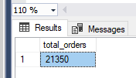
Pizza Hut
KPI
--Retrieve the total number of orders placed.
Query
select count(order_id) as total_orders from orders

Slide 4
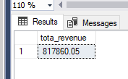
Pizza Hut
KPI
--Calculate the total revenue generated from pizza sales.
Query
select
round (sum (order_details.quantity* pizzas.price), 2) as tota_revenue
from order_details join pizzas
on order_details.pizza_id=pizzas.pizza_id

Slide 5
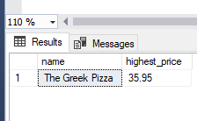
KPI
--Identify the highest-priced pizza.
Query
select top 1 pizza_types.name, round((pizzas.price),2) as highest_price
from pizza_types join pizzas on pizza_types. pizza_type_id= pizzas. pizza_type_id
order by highest_price desc
Pizza Hut

Slide 6
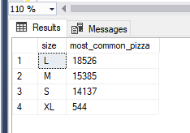
KPI
--Identify the most common pizza size ordered.
Query
select top 1 size, count(quantity) as most_common_pizza from order_details join pizzas
on order_details.pizza_id=pizzas.pizza_id
group by size order by most_common_pizza desc
Pizza Hut

Slide 7
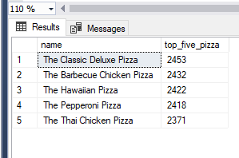
KPI
--List the top 5 most ordered pizza types along with their quantities.
Query
select top 5 name, sum(quantity) as top_five_pizza from order_details join pizzas
on order_details.pizza_id=pizzas.pizza_id join pizza_types on pizza_types.pizza_type_id=pizzas.pizza_type_id
group by name order by top_five_pizza desc
Pizza Hut

Slide 8
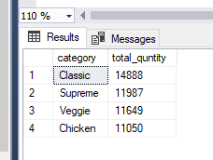
KPI
--Join the necessary tables to find the total quantity of each pizza category ordered.
Query
select pizza_types.category,
round(sum(order_details.quantity),2) as total_quntity
from order_details join pizzas
on order_details.pizza_id=pizzas.pizza_id
join pizza_types
on pizza_types.pizza_type_id=pizzas.pizza_type_id
group by category order by total_quntity desc;
Pizza Hut

Slide 9
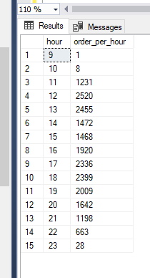
KPI
--Determine the distribution of orders by hour of the day.
Query
SELECT DATEPART(hour, time) AS hour, COUNT(order_id) AS order_per_hour
FROM orders
GROUP BY DATEPART(hour, time) order by hour;
Pizza Hut

Slide 10
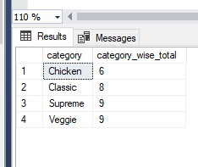
Pizza Hut
KPI
--Join relevant tables to find the category-wise distribution of pizzas.
Query
select category, COUNT (Name) as category_wise_total from pizza_types
group by category

Slide 11
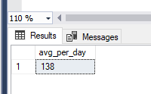

Pizza Hut
KPI
--Group the orders by date and calculate the average number of pizzas ordered per day.
Query
select avg (total_order_a_day) as avg_per_day from
(
select
orders.date, sum(order_details.quantity)
as total_order_a_day
from orders join order_details
on order_details.order_id=orders.order_id
group by date
) as order_quantity

Slide 12
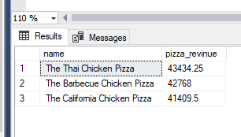
KPI
--Determine the top 3 most ordered pizza types based on revenue.
Query:
select top 3 pizza_types.name, SUM(pizzas.price*order_details.quantity) as pizza_revinue
from order_details join pizzas
on order_details.pizza_id=pizzas.pizza_id
join pizza_types
on pizzas.pizza_type_id=pizza_types.pizza_type_id group by name order by pizza_revinue desc
Pizza Hut

Slide 13
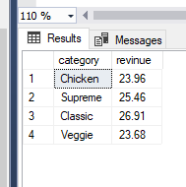
KPI
--Calculate the percentage contribution of each pizza type to total revenue.
Query
SELECT pizza_types.category, ROUND(SUM(order_details.quantity * pizzas.price) * 100 /
(SELECT ROUND(SUM(order_details.quantity * pizzas.price), 2) AS Expr1
FROM order_details INNER JOIN
pizzas ON order_details.pizza_id = pizzas.pizza_id), 2) AS revinue
FROM order_details INNER JOIN
pizzas ON order_details.pizza_id = pizzas.pizza_id INNER JOIN
pizza_types ON pizzas.pizza_type_id = pizza_types.pizza_type_id
GROUP BY pizza_types.category
Pizza Hut

Slide 14
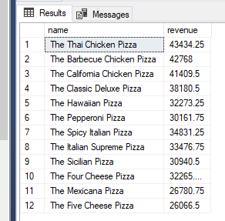
Pizza Hut
KPI
--Determine the top 3 most ordered pizza types based on revenue for each pizza category.
Query:
select name, revenue
from
(select category, name, revenue,
rank() over (partition by category order by revenue desc) as rn
from
(select pizza_types.category, pizza_types.name, sum (order_details.quantity*pizzas.price) as revenue
from pizzas join order_details
on order_details.pizza_id=pizzas.pizza_id join pizza_types
on pizza_types.pizza_type_id=pizzas.pizza_type_id
group by pizza_types.category, pizza_types.name) as a) as b where rn<=3

Slide 15
Pizza Hut
Thank You

